Slide 1
Digit Image Recognition Project
By Sai Swetha Pasam, Sumukhi Ganesan, Brendon Hahm

Slide 2
Introduction
Which model performs best in classifying handwritten digits?
For real time application (time complexity)
For accurate recognition of image (accuracy)
Can we recognize handwritten digits when handwriting induces variation in their representations?

Slide 3
Considerations
Image data is expensive to process
A lot of features when represented as matrix of images
Models vary in computational complexity
Any system for real time application requires both accurate and fast results

Slide 4
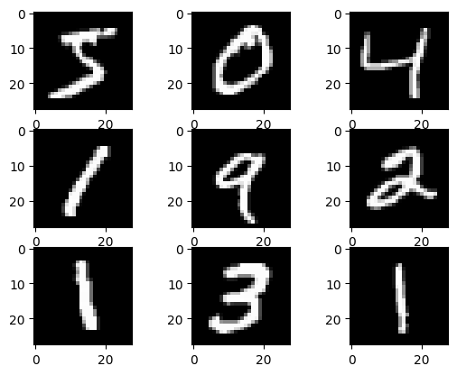
Images
MNIST dataset
28x28 size grayscale images
60,000 training images
10,000 testing images
All images are handwritten digits
Training set data comes from US Census Bureau employees
Testing set data comes from high school students

Slide 5
Pre-Processing
We have standardized the pixels
For KNN and SVM , we have flattened the images i.e convert 3D and 2D
For the general validation results , we have done
Padded the images to convert into 28 * 28 for CNN
We have gray scaled the images
Cropped of images to have similar aspect ratio

Slide 6
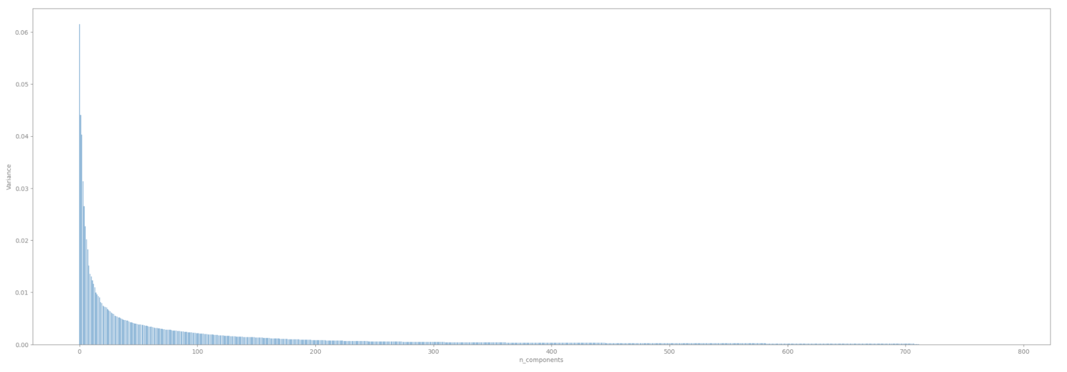
PCA
We have standardized the image before applying PCA
In the process of dimensionality reduction, we have included the components with variance <=90%
Out of 784 components, only 301 components are considered in further analysis
Still high dimensionality but feature space is significantly reduced nonetheless

Slide 7
KNN Approach
The testing portion of KNN for image data is computationally expensive
Exhibits computational limitations on cross validation and tuning
Brute force algorithm best for time complexity
Curse of dimensionality makes ball and kd tree worst performing than brute

Slide 8
ANNOY Approach
Approximate Nearest Neighbors (ANNOY) will also be used to help alleviate computational cost and for comparison
Accuracy will be worse but computational cost significantly lessened
Found feasible number of trees and samples through iteration

Slide 9
KNN & ANNOY Cont.
KNN
Neighbors = 5
Accuracy = 0.9691
ANNOY
Optimal Neighbors = 11
Best Accuracy = 0.9691

Slide 10
SVM Approach
Training SVM is less expensive than KNN
Tested linear and non linear kernel (rbf)
On test data , linear kernel gave us an accuracy of 92.8 % whereas rbf gave us an accuracy of 97.9%
Hyperparameter tuning is computationally expense

Slide 11
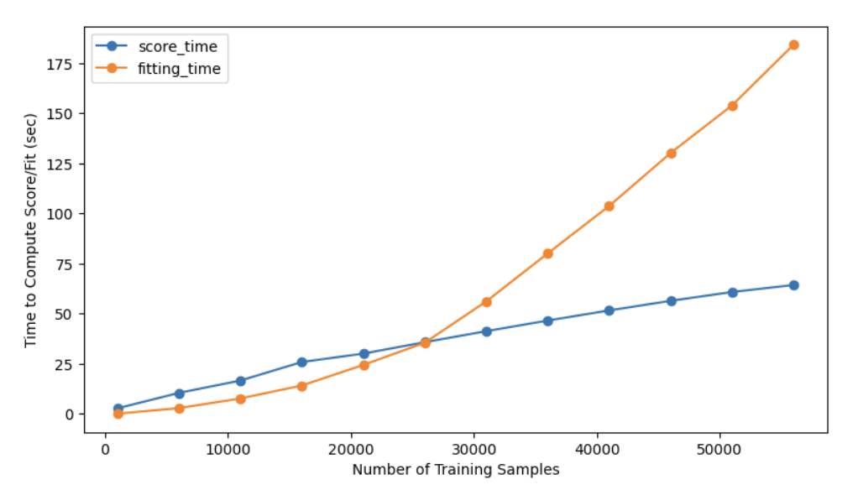
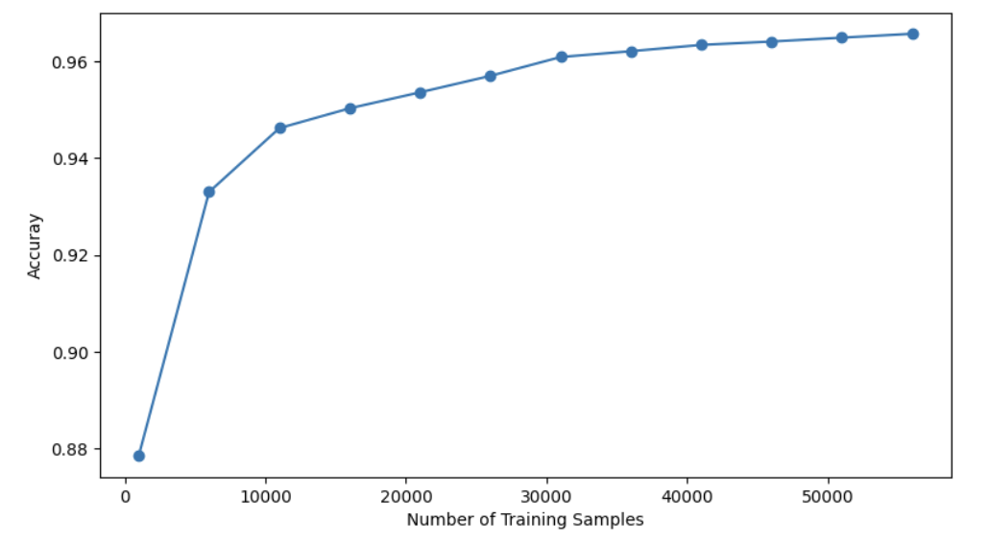
SVM Approach contd.
In the process of dimensionality reduction, we have included the components with variance <=90%
Post PCA, computational time has decreased
Best Hyper parameters - Optimal C and Gamma Combination: {'C': 10, 'gamma': 0.001, 'kernel': 'rbf'}
Post PCA and hyperparameter tuning -
Accuracy is ~97.23%

Slide 12
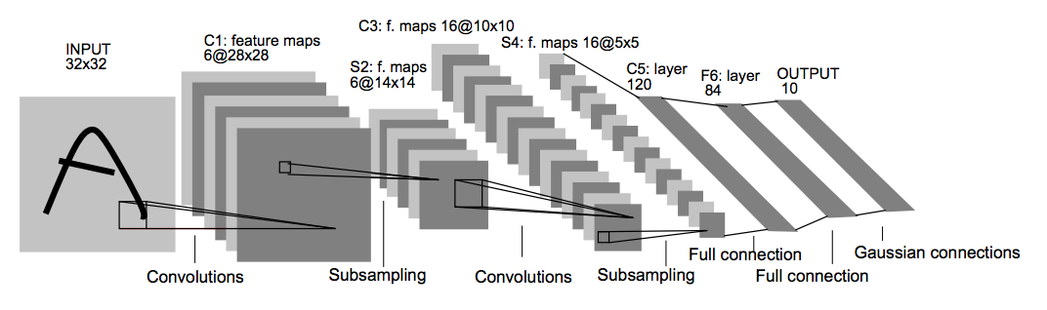
CNN Approach
LeNet-5 CNN model is used
The model contains 3 convolution, 2 subsampling, 2 fully connected layers
Activation function: ReLU
Training is computationally expensive.
Training parameters: 10 epochs, batch size 200, RMSProp (with learning rate = 0.001)

Slide 13
Model Comparisons
Metrics | KNN | ANNOY | SVM | CNN
Testing Accuracy | 96.9% | 96.3% | 97.9% | 99%
PCA Testing Accuracy | 95.3% | 93.7% | 97.5% | X
2vCPU and 5gb Ram on Deepnote

Slide 14
General Validation
32 images of handwritten digits were prepared
To assess the performance of our best model against general input
The training data could have been too biased towards the handwriting of census employees used for MNIST data generation

Slide 15
General Validation Results
So far with image preprocessing of new handwritten images, we get 0.78125 accuracy with CNN (27/32)
Likely to improve with further preprocessing of input images

Slide 16
Real Time Application
Among the three models, SVM and ANNOY seem the most promising due to their time and accuracy performance.
PCA with 90% variance retained helps models run significantly faster and avoid COD
Some accuracy is lost but that is to be expected

Slide 17
Overall Conclusions
PCA helps reduce computational time at the expense of some performance generally
ANNOY sees significant improvements in speed over KNN
CNN LeNet-5 model has the strongest performance
SVM performs the most balanced in terms of accuracy and speed tradeoff
With more observations and computational capacity, a real-time accurate model can be delivered.

Slide 18
Appendix

Slide 19
Model Comparisons
 | KNN | ANNOY | SVM linear | SVM rbf | CNN
Testing Accuracy | 0.9691 | 0.9631 | 0.928 | 0.979 | 0.99
Training Runtime | 0 | 0:08 | 0:04 | 0.07 | 6:32
Testing Runtime | 5:03 | 0:03 | 0:09 | 0.34 | 0:03
PCA Testing Accuracy | 0.9539 | 0.937 | X | 0.975 | X
PCA Training Runtime | 0:15 | 0:03 | X | 0:01 | X
PCA Testing Runtime | 0:15 | 0:00 | X | 1:00 | X
2vCPU and 5gb Ram on Deepnote

Slide 20
GitHub Repo
https://github.com/swethapasam/Hand-Digit-Recognition-Using-ML-Techniques

